Slide 1
Full Stack Presentation
Welcome To
On
Airline Reservation

Slide 2
About Project
The Project is based on Front End Web Development, in this project I have designed and created a Static website or front End of an Airline Reservation. I have used HTML, CSS, JavaScript, Bootstrap and JQuery to develop my website. This website is fully responsive and quite good colours and arrangement of different items.
Airline Reservation System contains the details about flight schedules and its fare tariffs, passenger reservations and ticket records.
Airline Reservation System will hold flight schedules and its fare tariffs, passenger reservations and ticket records. It saves time as it allows online procedure as users no longer to wait in a queue to book the flights. It is automatically generated by the server.
Admin is the main authority who can do addition, deletion, and modification of flights if required.

Slide 3
Project Description
Disadvantages
Manually goes to the Airport and book his ticket.
Downloading the ticket form as paper document, filling it manually and submitting it at Airport.
Fill the Ticket form on system and get the print out as paper documents to submit it at Airport.
Booking the Ticket at some particular registered ticket counters in online.
Even above approaches make a ticket booking online, it was not completely done on online. Passenger may not have much freedom over this approach.
Hence the Passenger may or may not be satisfied with this approach as it includes manual intervention like travelling to Airport for booking his ticket.
Cannot Upload and Download the latest updates.
No use of Web Services and Remoting.
Risk of mismanagement and of data when the project is under development.
Less Security.
No proper coordination between different Applications and Users.
Fewer Use friendly.

Slide 4
Project Description
Advantages:
User friendliness provided in the application with various controls.
The system makes the overall project management much easier and flexible.
It provides high level of security with different level of authentication.

Slide 5
Technologies Used
HTML5: HTML5 is a mark-up language used for structuring and presenting content on the World Wide Web. It is the fifth and latest major version of HTML that is a World Wide Web Consortium recommendation.
HTML is the standard mark-up language for creating Web pages.
HTML describes the structure of a Web page.
HTML consists of a series of elements.
HTML elements tell the browser how to display the content.
CSS3: Cascading Style Sheets (CSS) is a style sheet language used for describing the look and formatting of a document written in a mark-up language.
CSS describes how HTML elements are to be displayed on screen, paper, or in other media
CSS saves a lot of work. It can control the layout of multiple web pages all at once

Slide 6
JavaScript:
JavaScript often abbreviated as JS, is a programming language that conforms to the ECMAScript specification. JavaScript is high-level, often just-in-time compiled, and multi-paradigm. It has curly-bracket syntax, dynamic typing, prototype-based object-orientation, and first-class functions.
Alongside HTML and CSS, JavaScript is one of the core technologies of the World Wide Web. JavaScript enables interactive web pages and is an essential part of web applications. The vast majority of websites use it for client-side page behaviour, and all major web browsers have a dedicated JavaScript engine to execute it.
Bootstrap:
Bootstrap is a free and open-source tool collection for creating responsive websites and web applications. It is the most popular HTML, CSS, and JavaScript framework for developing responsive, mobile-first web sites. It solves many problems which we had once, one of which is the cross-browser compatibility issue. Nowadays, the websites are perfect for all the browsers (IE, Firefox and Chrome) and for all sizes of screens (Desktop, Tablets, Phablets, and Phones). All thanks to Bootstrap developers -Mark Otto and Jacob Thornton of Twitter, though it was later declared to be an open-source project.

Slide 7
JQuery:
jQuery is a lightweight, "write less, do more", JavaScript library.
The purpose of jQuery is to make it much easier to use JavaScript on your website.
jQuery takes a lot of common tasks that require many lines of JavaScript code to accomplish, and wraps them into methods that you can call with a single line of code.
jQuery also simplifies a lot of the complicated things from JavaScript, like AJAX calls and DOM manipulation.

Slide 8
Moving towards
Project

Slide 9
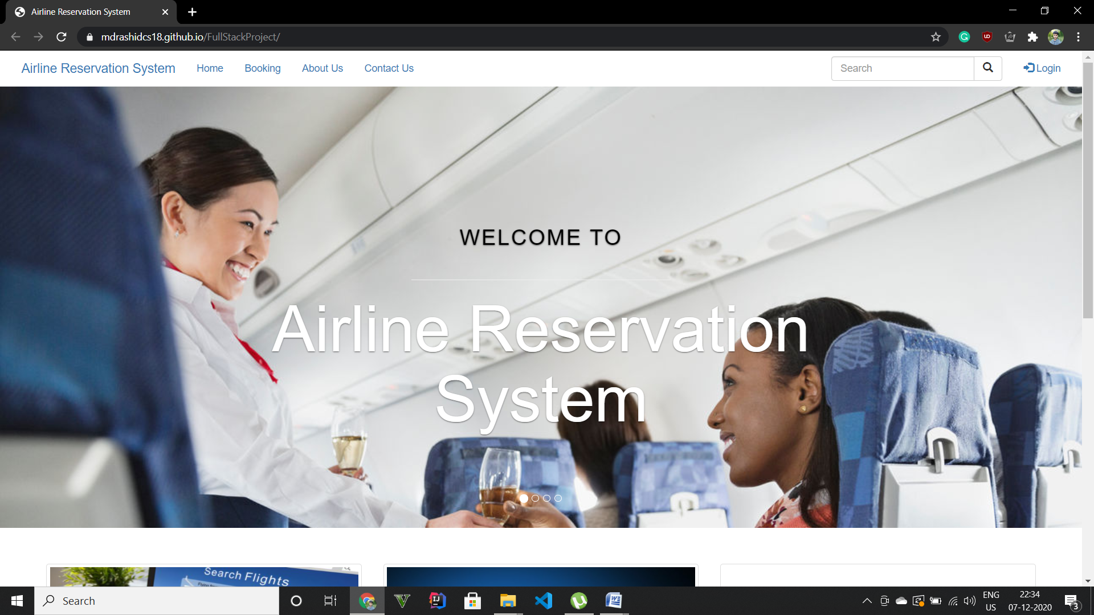
HOMEPAGE

Slide 10
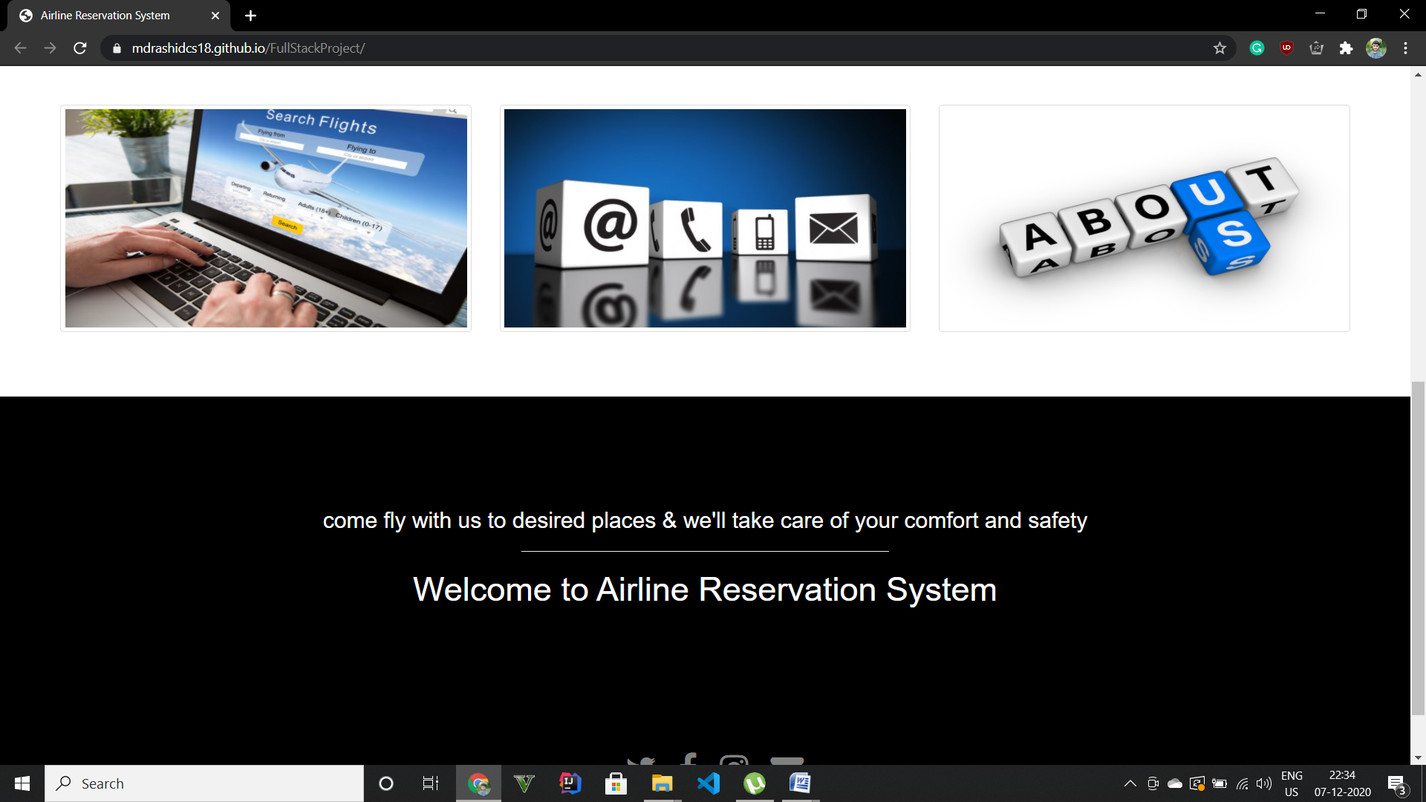
HOMEPAGE

Slide 11
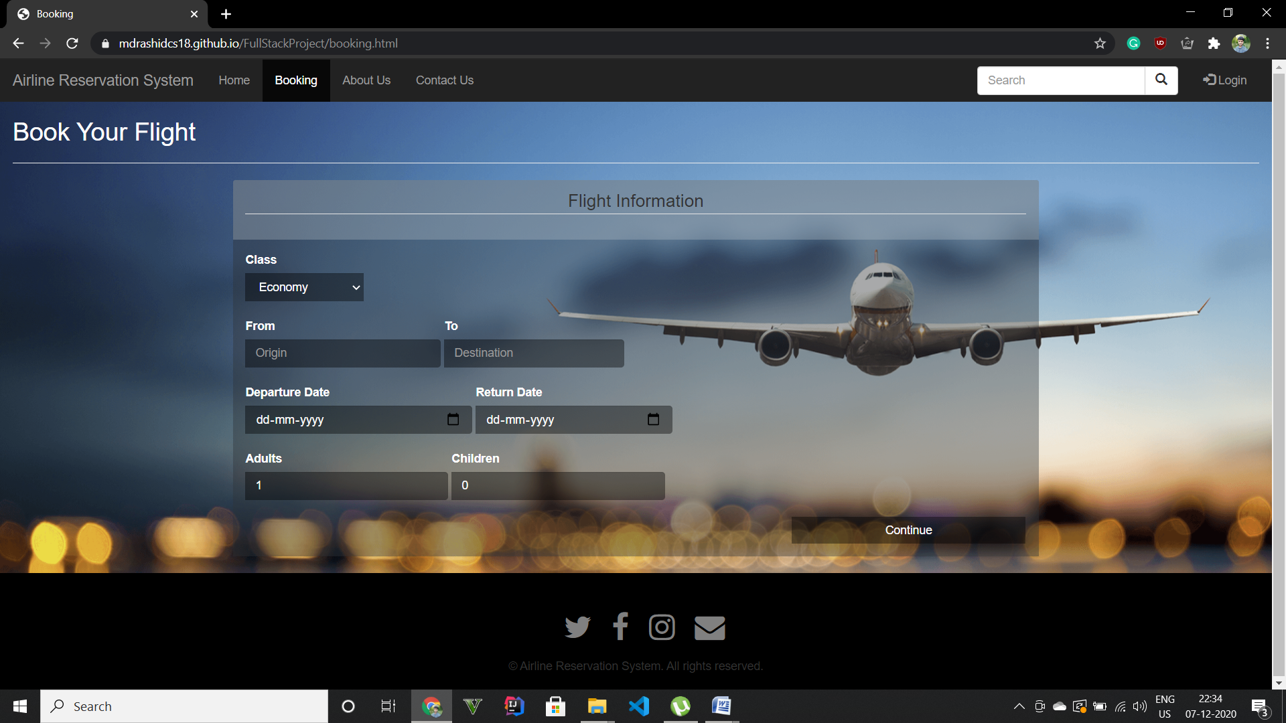

Slide 12
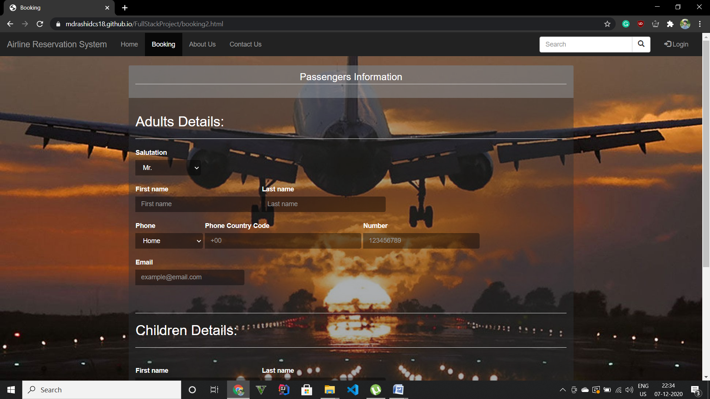

Slide 13
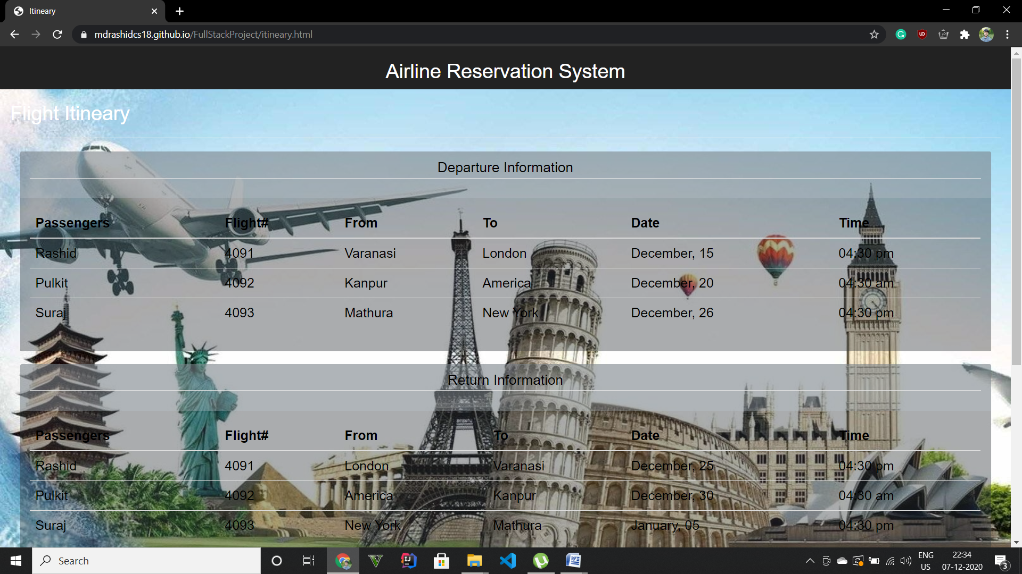

Slide 14
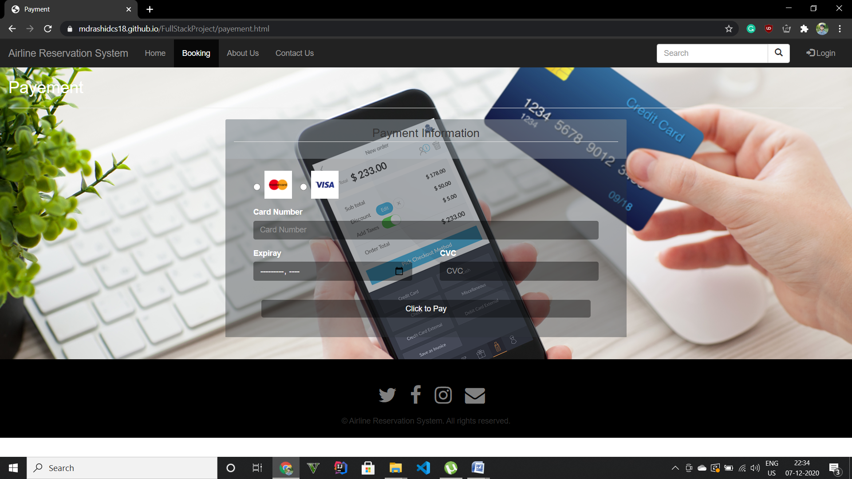

Slide 15
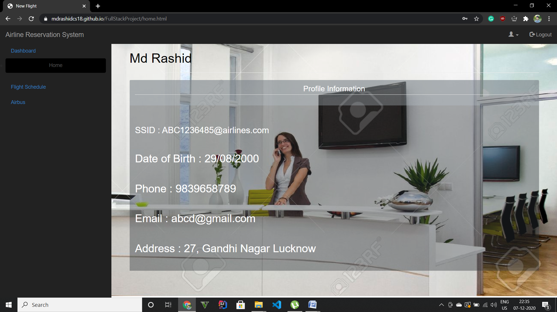

Slide 16
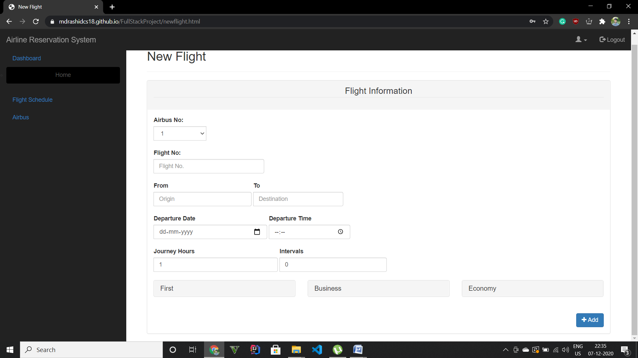

Slide 17
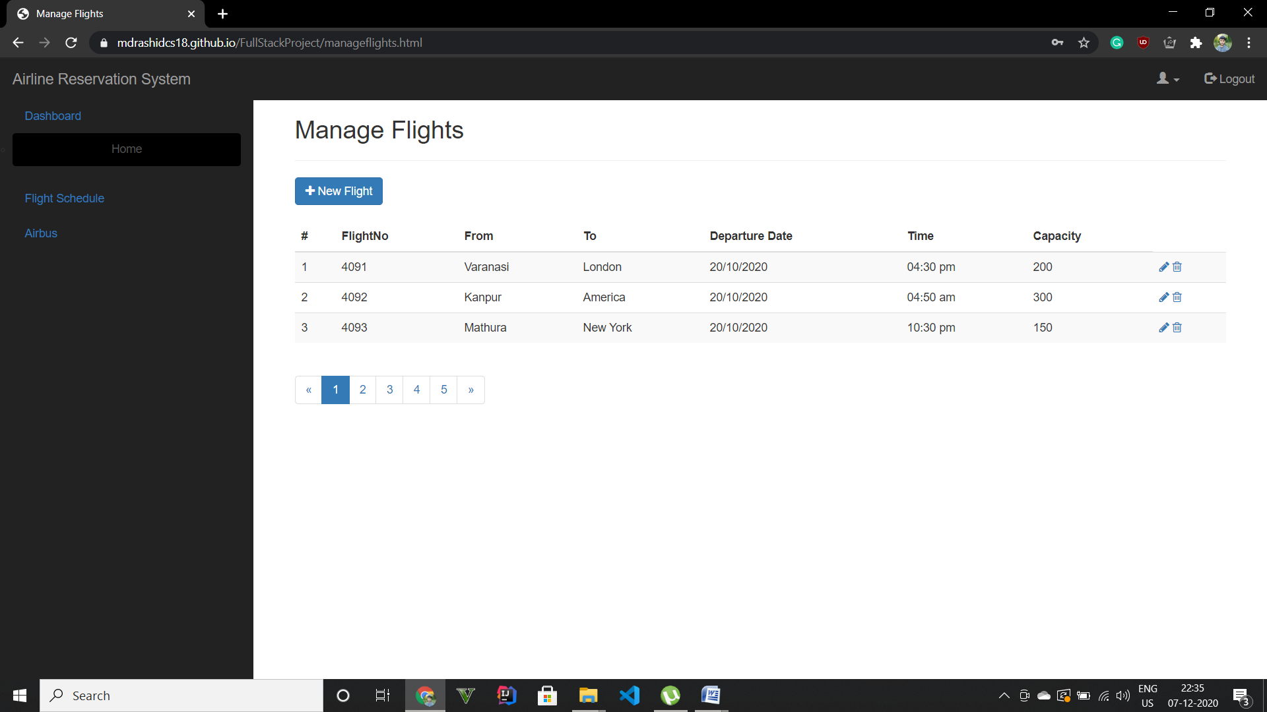

Slide 18
